Slide 1
HEALTH LINK
An innovative Healthcare management system

Slide 2
Presented by:
B. Anameka
S. Purvaja
V. Brindha
B.Sc. Computer Science with Artificial Intelligence

Slide 3
INTRODUCTION
HEALTH LINK is an Innovative hospital management is crucial for delivering superior patient care. This presentation explores key strategies and technologies to enhance operational efficiency and improve patient outcomes.

Slide 4
CHALLENGES IN HOSPITAL MANGEMENT
The main challenges are faced in Hospitals are Managing patient flow, optimizing resource allocation, and ensuring compliance, ensuring patient safety and satisfaction, maintaining efficient communication with staffs are key challenges in hospital management. Addressing these issues is essential for delivering high-quality patient care.

Slide 5

TECHNOLOGY SOLUTION
Balancing these factor while-delivering quality care within budget constrains is often a significance challenge for hospital management. Incorporating advanced healthcare IT systems and leveraging data analytics can streamline processes, improve decision-making, and enhance patient care. Implementing these technologies is essential for modern hospital management.

Slide 6
This Donut chart represents the patient health improvement while using IOT and hospital staff. How much it works and predict the patient illness by using data.

Slide 7

PATIENT CENTRIC APPROACH
Adopting a patient-centric approach involves prioritizing patient experience, personalized care, and effective communication.
This approach is fundamental for achieving superior patient care and satisfaction.

Slide 8
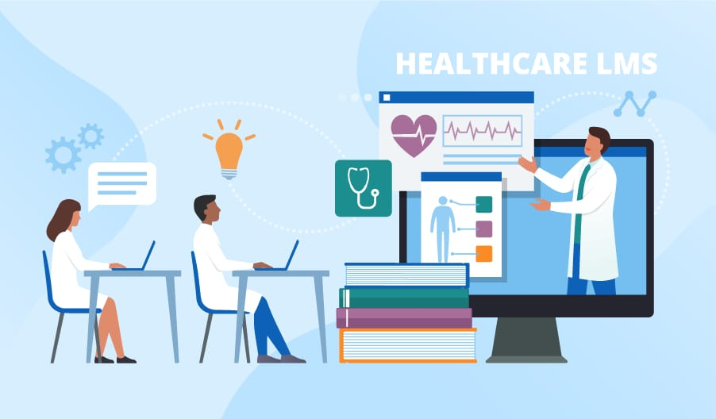
STAFF TRAINING AND ENGAGEMENT
Investing in continuous staff training and promoting employee engagement are vital for fostering a culture of excellence and ensuring high-quality patient care. Empowered and motivated staff contribute to superior patient outcomes.

Slide 9
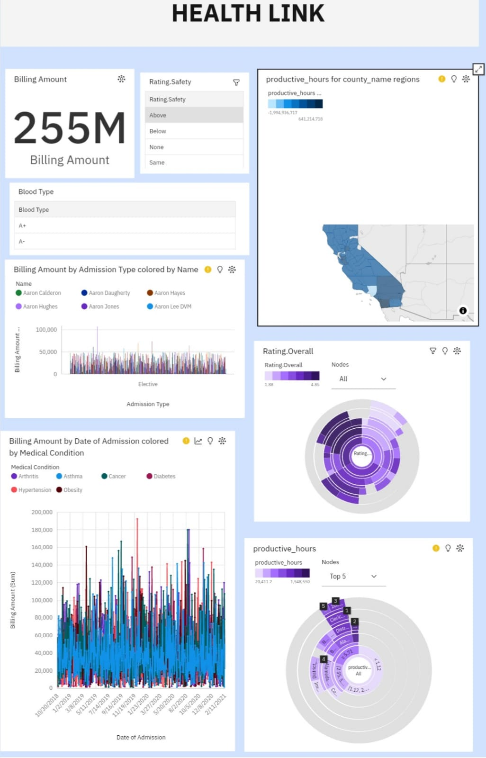

Slide 10
What we are see above is our project reported output and here we have done a lot of data includes in this reports like Patient records, medical procedures, staff scheduling, financial information and virtual patient care sensor data from kaggle website. We upload the all data to the COGNOS tool used for using BI offer by by IBM and generate the project report.

Slide 11


Slide 12
CONCLUSION
Transforming hospital management through innovative strategies and technologies is imperative for delivering superior patient care. By addressing challenges, leveraging technology, prioritizing patients, and empowering staff, hospitals can achieve excellence in patient care.

Slide 13
References
https://ap2.ca.analytics.ibm.com/bi/?perspective=dashboard&pathRef=.my_folders%2Fhealthlink&action=view&mode=dashboard&subView=model0000018f064634c8_00000000
https://github.com/Anameka/Health-Link.git
This link is used to check the implementation and outcomes of our report.

Slide 14
THANK YOU FOR LISTENING OUR PRESENTATION AND PROJECT REPORT

